Slide 1


INT423 Machine Learning-II
Lecture #0
Agenda, Roadmap & Expectations

Slide 2

Course details
LTP – 2 0 2
Credits – 3.0
Mode – BYOD
Text Book
MACHINE LEARNING : A PRACTITIONER by CHANDRA S.S., VINOD HAREENDRAN S., ANAND, PHI Learning
HANDS-ON DATA SCIENCE AND PYTHON MACHINE LEARNING by FRANK KANE, PACKT PUBLISHING

Slide 3
Course Assessment Model
Marks break up*
Attendance 5
CA 25
Project(10 Marks execution, 15 marks viva and presentation, 5 marks report)
1 Best out of 2 Test-code based
MTE 20
ETE 50
Total 100

Slide 4
Course Outcomes
CO1 :: discuss the fundamental concept of unsupervised learning
CO2 :: apply popular clustering algorithms like K-means clustering, hierarchical tree, agglomerative clustering, DBSCAN clustering on a real dataset
CO3 :: assess the performance of clustering algorithms using appropriate metrics
CO4 :: learn the foundational concepts in reinforcement learning, including agents, environments, actions, rewards, and policies
CO5 :: associate the concept of Temporal Difference (TD) learning methods, such as Q-learning
CO6 :: obtain knowledge about different types of recommender systems, including collaborative filtering, content-based filtering

Slide 5
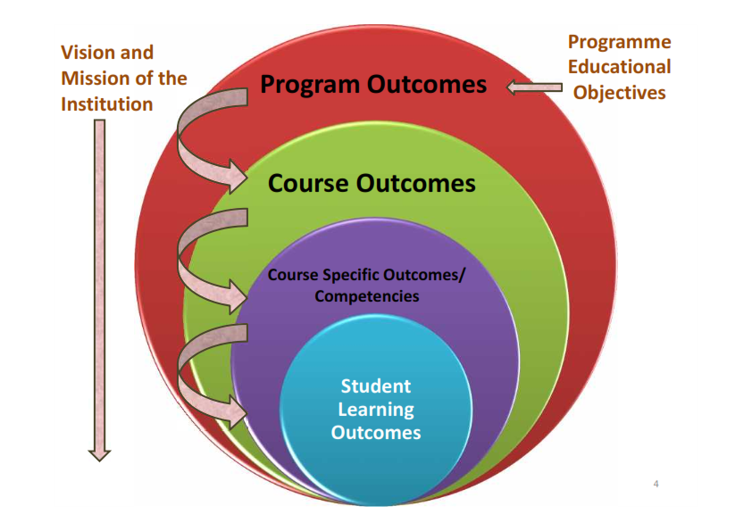
Program Outcomes
PO-1 Engineering knowledge::Apply the knowledge of mathematics, science, engineering fundamentals, and an engineering specialization to the solution of complex engineering problems.
PO-2 Problem analysis::Identify, formulate, research literature, and analyze complex engineering problems reaching substantiated conclusions using first principles of mathematics, natural sciences, and engineering sciences.

Slide 6
Program outcomes
PO-3 Design/development of solutions::Design solutions for complex engineering problems and design system components or processes that meet the specified needs with appropriate consideration for the public health and safety, and the cultural, societal, and environmental considerations.
PO-6 The engineer and society::Apply reasoning informed by the contextual knowledge to assess societal, health, safety, legal and cultural issues and the consequent responsibilities relevant to the professional engineering practice.
PO-12 Life-long learning::Recognize the need for, and have the preparation and ability to engage in independent and life-long learning in the broadest context of technological change.
PO-13 Competitive Skills::Ability to compete in national and international technical events and building the competitive spirit
6

Slide 7
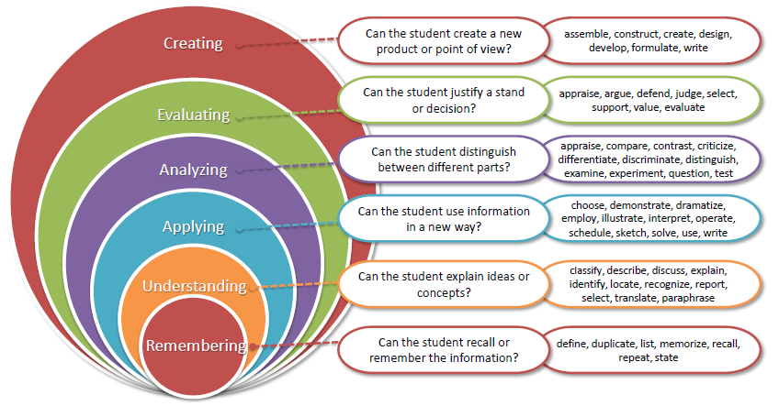
Revised Bloom’s taxonomy (RBT)
7

Slide 8
What are Cohorts
A group of students of a common programme who intend to attain similar characteristics by means of learning similar skills in order to target a particular career opportunity.

Slide 9
Purpose of Cohorts
Student shall be able to have a goal oriented approach for his/her career
Student identifies the goal in the very first year
Student shall be able to follow the stage wise career progression.
Early identification of skill set required for selected goal.

Slide 10
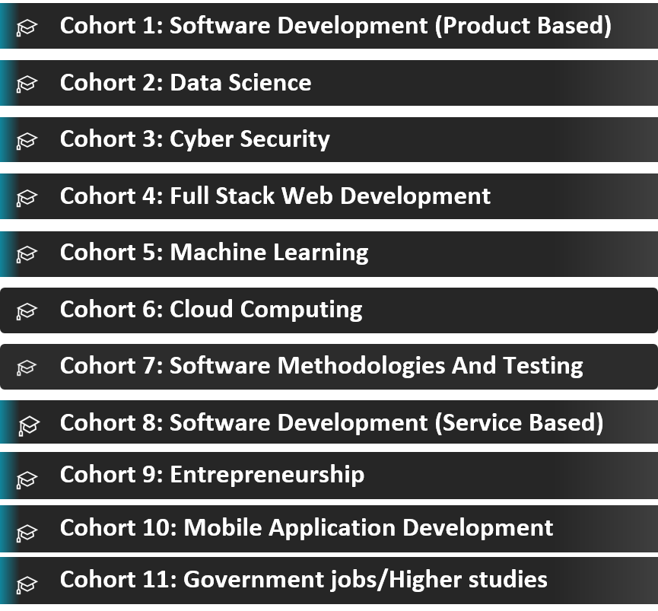
INT423 – Cohort 5

Slide 11
The course contents: Unit 1
Machine learning clustering algorithms-I
Introduction to unsupervised learning
What is clustering?
K-means intuition
K-means algorithm
Optimization objective
Initializing K-means
Choosing the number of clusters
hard versus soft clustering
using the elbow method to find the optimal number of clusters

Slide 12
The course contents: Unit 2
Machine learning clustering algorithms-II
: Finding unusual events
Gaussian (normal) distributio
Anomaly detection algorithm
Anomaly detection vs. supervised learning
Choosing what features to use(PCA)
organizing clusters as a hierarchical tree,
agglomerative clustering
DBSCAN clustering

Slide 13
The course contents: Unit 3
Clustering metrics
Silhouette Score
Davies-Bouldin Index
Dunn Index
Adjusted Rand Index (ARI),
Normalized Mutual Information (NMI)
Homogeneity
Completeness, and V-measure
FowlkesMallows Index
Adjusted Mutual Information (AMI)

Slide 14
The course contents: Unit 4
Reinforcement Learning-I
What is Reinforcement Learning?
The Return in reinforcement learning
Making decisions: Policies in reinforcement learning
Review of key concepts
State-action value function definition
State-action value function example
Bellman Equation
Learning the statevalue function

Slide 15
The course contents: Unit 5
Reinforcement Learning-II
Introduction to Q learning
Q learning algorithm
Algorithm refinement: Improved neural network architecture
Algorithm refinement: ?-greedy policy
Algorithm refinement: Mini-batch and soft updates
The state of reinforcement learning

Slide 16
The course contents: Unit 6
Recommender Systems
Making recommendations
Using per-item features
Collaborative filtering algorithm
Binary labels: favs
likes and clicks
Mean normalization
Content-based filtering
Collaborative filtering vs Content based filtering
Ethical use of recommender systems

Slide 17
MOOC
https://www.coursera.org/learn/unsupervised-learning-recommenders-reinforcement-learning/home/week/1
Coursera : Unsupervised Learning, Recommenders, Reinforcement Learning

Slide 18
Skill Set
EMPLOYABILITY
Advanced Python Programming

Slide 19


